Slide 1
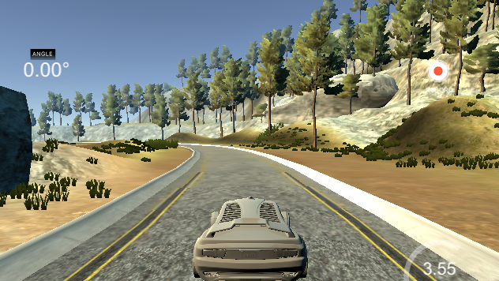
BEHAVIORAL CLONING

Slide 2
Solution Design Approach
The final solution was achieved in a succession of iterative approach.
Iteration 1: Initially I started with comma.ai’s model as my model architecture (https://github.com/commaai/research/blob/master/train_steering_model.py, research paper - https://arxiv.org/abs/1608.01230v1). I thought this model might be appropriate after reading about it in the Udacity’s cheat sheet guide. The model uses video frames of 320 X 160 pixels region and such seemed ideal for the dataset provided by Udacity for the project. The model normalized the data and has 3 subsequent convolution layers with 16, 32, 64 filters respectively. It has dropout layers to counter overfitting and exponential linear unit for activation which leads to fast and accurate learning. Training and Validation Generators were used for learning with Adam optimizer and model checkpoint for saving the best weights. The result was a very slow network even with 3 epochs and batch size of 32 on the local machine and took over 5 hours to complete the training. The trial on the simulator failed very soon with the car going out of the track in just a few distance.
Iteration 2: This time I introduced a cropping layer of ((70,20), (0,0)) and trained the model on resized YUV images of 320 X 80 on aws adding keras’ callback Early Stopping. The learning was comparatively faster on the GPU around an hour. The trial on simulator only improved somewhat and failed driving left at the track limit red markers, the bridge and then at the dirt with subsequent iterations & trials.
Iteration 3: To combat the left driving bias I augmented the dataset with flipped images. This time it drove much better however the training process was much slowed down. It still failed at sharper turns with higher speed.
Iteration 4: The next solution approach was influenced by reading the blog https://medium.com/@xslittlegrass/self-driving-car-in-a-simulator-with-a-tiny-neural-network-13d33b871234. The key was reducing the input image size to the limit. With input of 32X16 images and readjusted cropping layer, I could get rid of the slower generators and fit all the data at once in memory. The result was a blazing fast network trained in just under 1 minute in local laptop and the vehicle is now able to drive autonomously around the track without leaving the road.

Slide 3
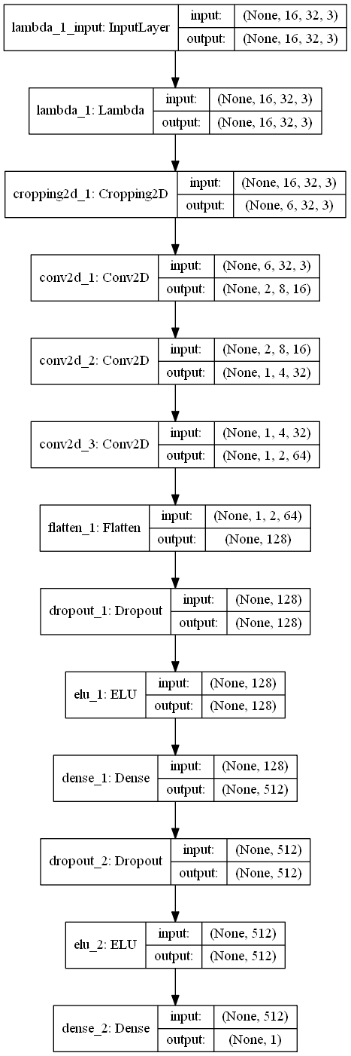
Final Model Architecture
The final model architecture (model.py lines 54-67) consisted of a convolution neural network with the following layers and layer sizes. Model Visualization to the right.
Layer | Description | Param #
Input | Input16X32X3 YUV image | 0
Lambda - Normalization | x / 127.5 - 1.0 | 0
Cropping | dimensions ((7,3),(0,0)), output 6X32X3 | 0
Convolution 8x8, filter=16 | stride 4x4, same padding, activation = ELU, output 2X8X16 | 3088
Convolution 5x5, filter=32 | stride 2x2, same padding, activation = ELU, output 1X4X32 | 12832
Convolution 5x5, filter=64 | stride 2x2, same padding, activation = ELU, output 1X2X64 | 51264
Flatten | Input 1x2x64, output 128 | 0
Dropout | 0.2 | 0
Activation | ELU | 0
Fully connected | Input 128, activation = ELU, output 512 | 66048
Dropout | 0.5 | 0
Activation | ELU | 0
Fully connected | Input 512, output 1 | 513
Total parameters: 133,745
Trainable parameters : 133,745
Non-trainable parameters : 0

Slide 4
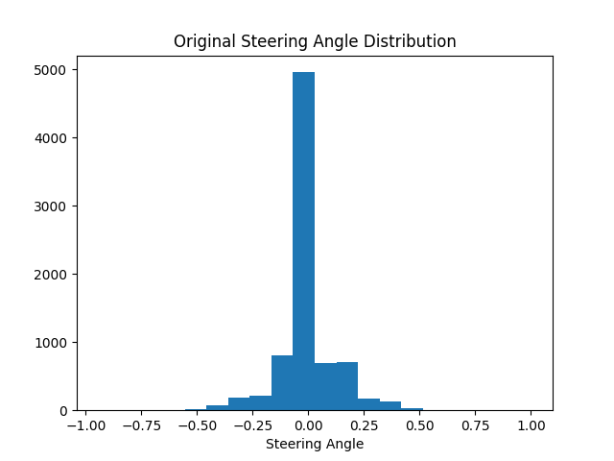
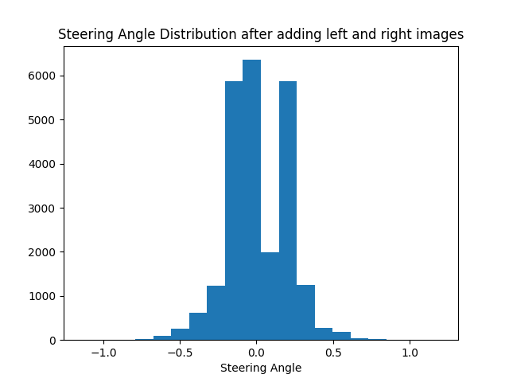
Creation of the Training Set & Training Process
I decided to use the training dataset log provided with the project which has 8036 data points. Since steering angle is of our interest to help learn the model how to turn the car we plot the histogram to study the original distribution (see Original Steering Angle Distribution). The distribution is heavily biased and would only drive straight if trained with this dataset.
The given log also has images taken from the left and right camera, combining them totals to 24,108 images in all for the training. The reason I decided to include both the left and right images in training along with the center image since using the left and right images teaches the model how to steer if the car drifts off to the left or the right thereby minimize the need for recovery driving. After adding these left and right images to the training along with the corresponding assumed angles (lines 30-37 in model.py), we examine the distribution as in fig below right where the biased has been reduced to some extent. It still got more steering to the left but the track layout reflects the same (more left turns than right) . The dip in the distribution is since the track has not any right turns except one sharp right turn at the end which requires a higher steering angle.
For the image pre-processing, the images were converted to YUV color-space as mentioned in NVIDIA paper. YUV color-spaces are a more efficient coding and reduce the bandwidth more than RGB capture. The images were further resized to 32X16 to be able to load all the images at once into memory instead of using the much slower generators.

Slide 5
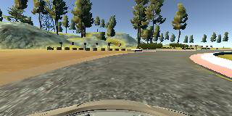
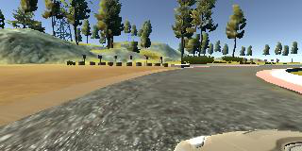
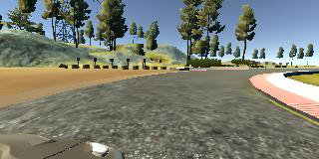
Creation of the Training Set & Training Process
The original images – center/left/right.
The images in YUV space and resized to 32X16 size (enlarged for representation)
We can see in YUV space the road is distinguishable from the dirt.
To further combat the left driving bias at sharper turns the images were flipped and added to the training along with the negative steering angles. At this point in the collection process, I had about 50,000 number of data points.

Slide 6
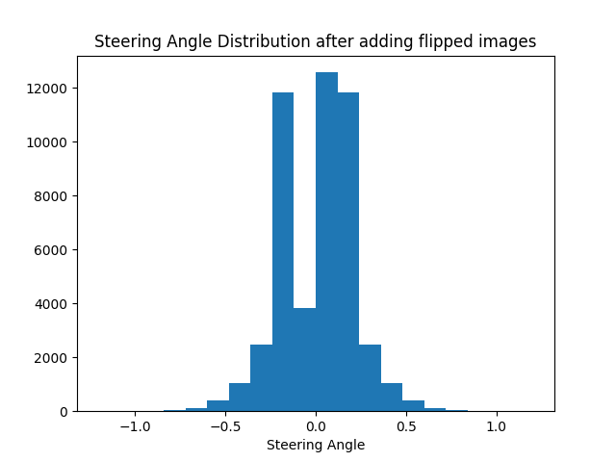
Creation of the Training Set & Training Process
The flipped images
The steering distribution in the data after flipping looked like as in histogram to the right. Now it
looked we had enough data for the training.
For training-test split ratio, I put 10% of the data into the validation set after randomly shuffling
the data set , Train on 43394 samples, validate on 4822 samples. However as noted in the
Udacity project guide, you only need to predict with the center camera image so there is room
for improvement to validate against a set of center images only but it wasn’t needed.
In the initial trials, the model was trained with batch size of 32 shuffled images using generators
with an epoch of 3 and Adam optimizer. The best weights were saved using the ModelCheckpoint.
Later on, I added EarlyStopping to stop the learning process if it does not improve the validation
loss thereby avoiding overfitting. After the input images were resized to a dimension of 16X32, all
the data was able to be fit into the memory, and thus a generator was not needed. The model
was then trained with batch size of 256, shuffled and epoch of 20. I also switched to the Nadam
optimizer which combines the best of Adam and Nesterov accelerated gradient.

Slide 7
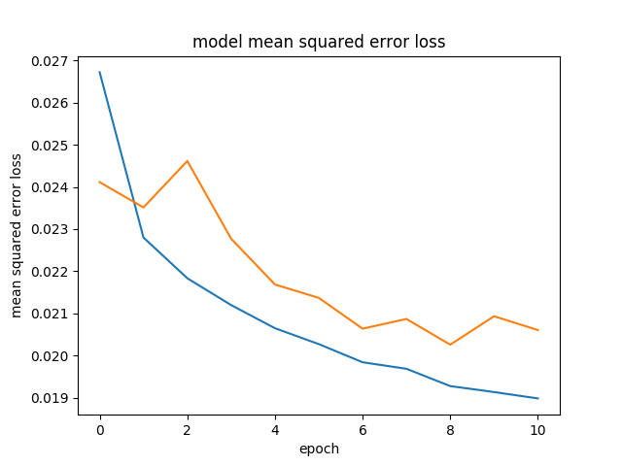
Creation of the Training Set & Training Process
Some of the preprocessing on the images was done in the model layer such as normalization and cropping.
The following images represent how they would look.
Cropped and normalized images. The yellow marks the road.
With this model the learning converges very fast in just a few epochs, the validation
accuracy usually flattens out well quickly and with EarlyStopping the learning process
is stopped when validation loss tend to increase. Finally using this model, the simulator
is able to drive the car around the track efficiently without leaving the road.

